Slide 1



Protecting Your Assets In A Hostile Legal Environment
Presented By:

Slide 2
Introduction
Asset Protection of concern to just about everyone
Real Estate Investors
Small Business Owners:
  The employee who runs an errand during company hours –
    - And is involved in a car accident
The cute Yorkie – who bits your AC repair man
Teenager Driving Your car***

Slide 3
May the odds be with you – but frankly they’re not
More than 60 percent of doctors over the age of 55 have been sued at least once, according to a new survey by the American Medical Association (AMA).
65 percent of claims are dropped or dismissed, but still costly to defend

Slide 4
Our Last Seminar: True Starting Point
Keep Legal Control In the Family –
Avoid Court Intervention
First Part of Good Estate Plan
Second Part: Asset Protection

Slide 5
Smart Estate Planning: Keeping
Control In The Family
As Americans, we are used to having control
No one wants the court to intervene in your personal affairs
Losing Control: In event of mental incapacity:
  Over 87% chance likely to suffer mental incapacity prior to death
  What could happened in such event? GUARDIANSHIP
  What is Guardianship?

Slide 6
Keeping Control In The Family
Probate: Court intervention upon death
What is Probate
Why most families want to avoid probate
  Cost
  Time
  Stress

Slide 7
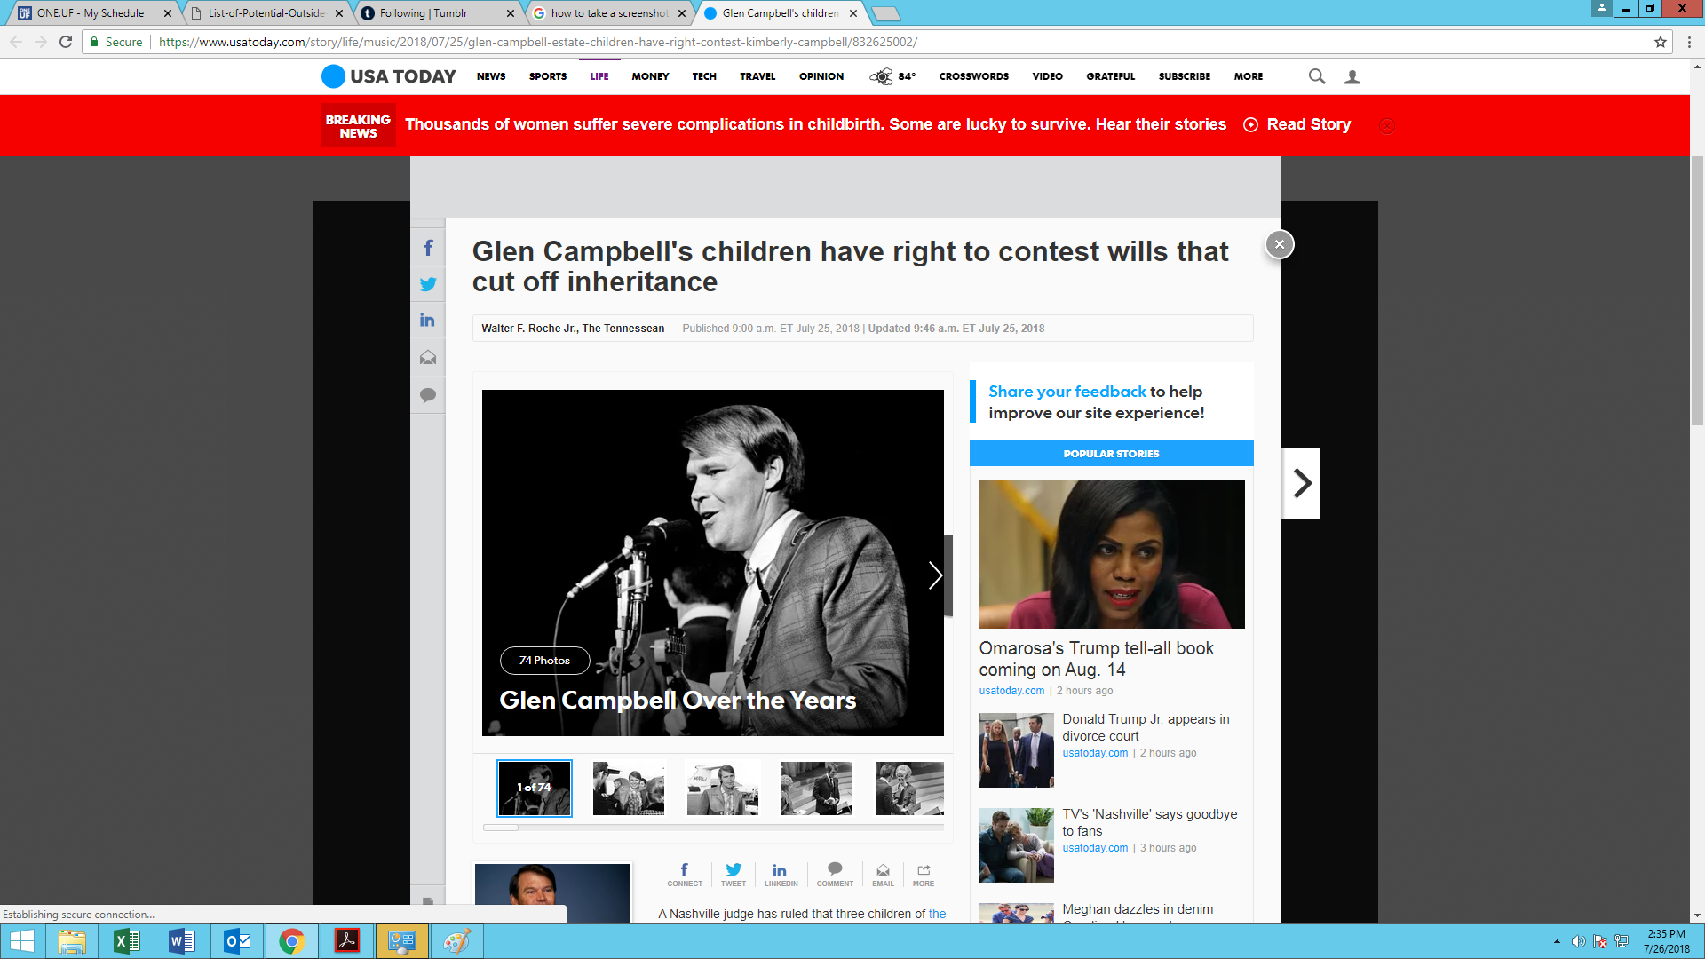

Slide 8
3 Myths About Probate – and the Realities
A will avoids probate
A non-funded living trust avoids probate
Owning real estate with adult child avoids probate – maybe & maybe not

Slide 9
Common Estate Planning Mistakes

Slide 10
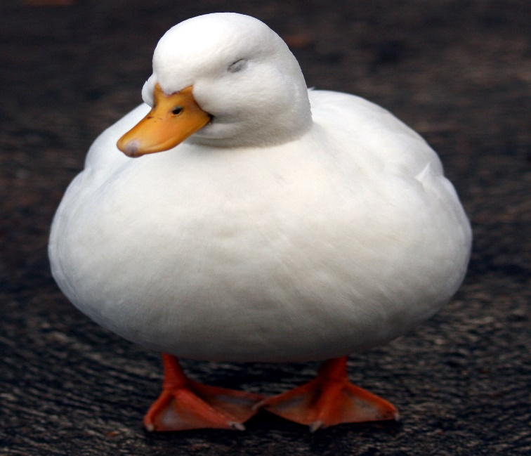
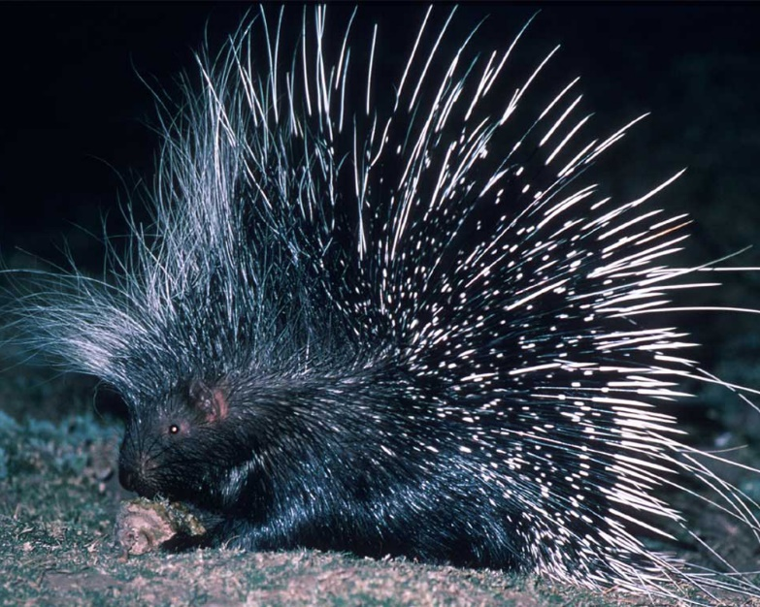
Mistake #1: Failure to Protect Your Low Hanging Fruit
What assets are low hanging fruit?
Is it a porcupine or a fat duck?

Slide 11
What Makes a Fat Duck?
Title in your individual name – and loaded with insurance
Title in single member LLC
Multiple properties in same LLC
LLC without an anti-Olmstead Operating Agreement

Slide 12
What Makes A Fat Duck
Title in name of a sub-s corporation: Not Fat Duck but not optimal
Title in name of corporation – and no annual minutes or corporate Bank account
Watch out for the wolves

Slide 13


Slide 14


Who Survives?

Slide 15
Moral of the Story
Understand the Porcupine Strategy: Make Assets Unattractive to Creditors
The “No Fat Ducks Rule”

Slide 16
Mistake #2: Failure to Have An Asset Protection Strategy
Because if you don’t, someone else may
– as Linus learned the hard way

Slide 17
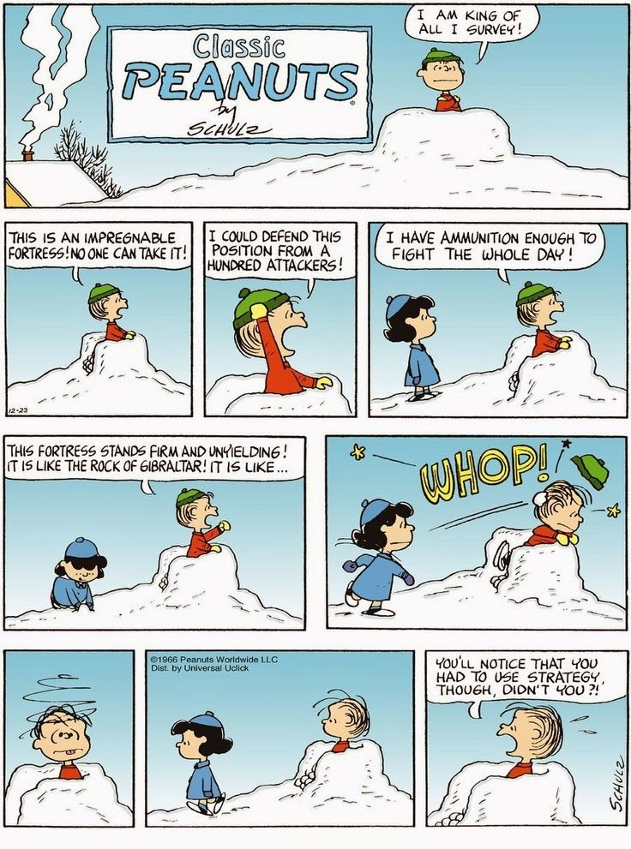

Slide 22
Take Away Points
Have an Asset Protection Strategy
  Take Advantage of Florida laws!!!
  If necessary, take advantage of laws of other states:
    Nevada, Delaware, South Dakota, Alaska
Make Sure Your Strategy is Up to date
Not such thing as “bullet proof” strategy Or Impregnable Fortress
But Plenty of Powerful Legal Tools and Strategies

Slide 23
Mistake #3: Waiting Too Long To Take Action
Plan when you can
  If you lack capacity – you are looking at court intervention (See Glen Campbell estate)
Crisis planning is expensive and your options are limited
Solution: Act Now
Even if the choices are not perfect – usually never perfect
Linus may agree

Slide 24


Slide 25
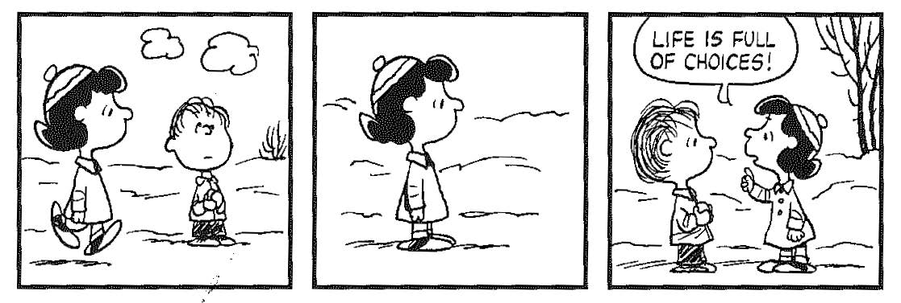

Slide 26
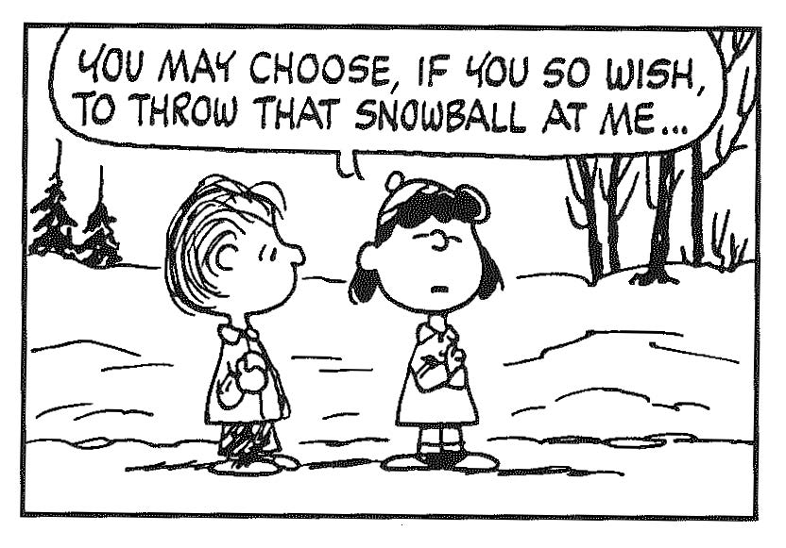

Slide 27
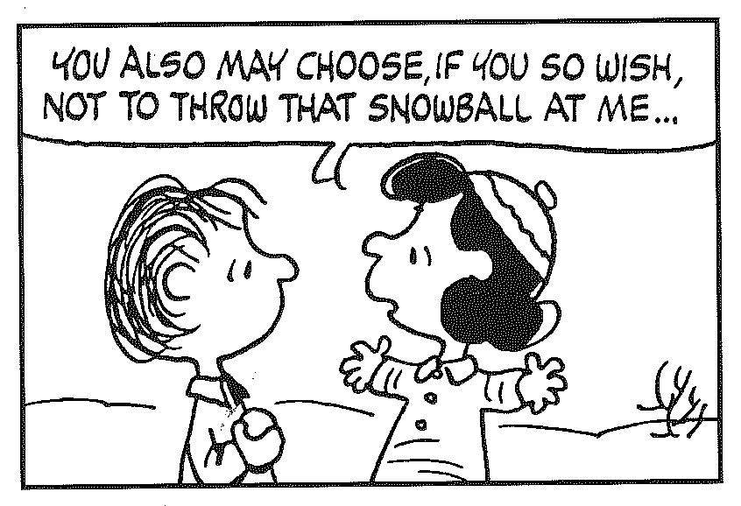

Slide 28
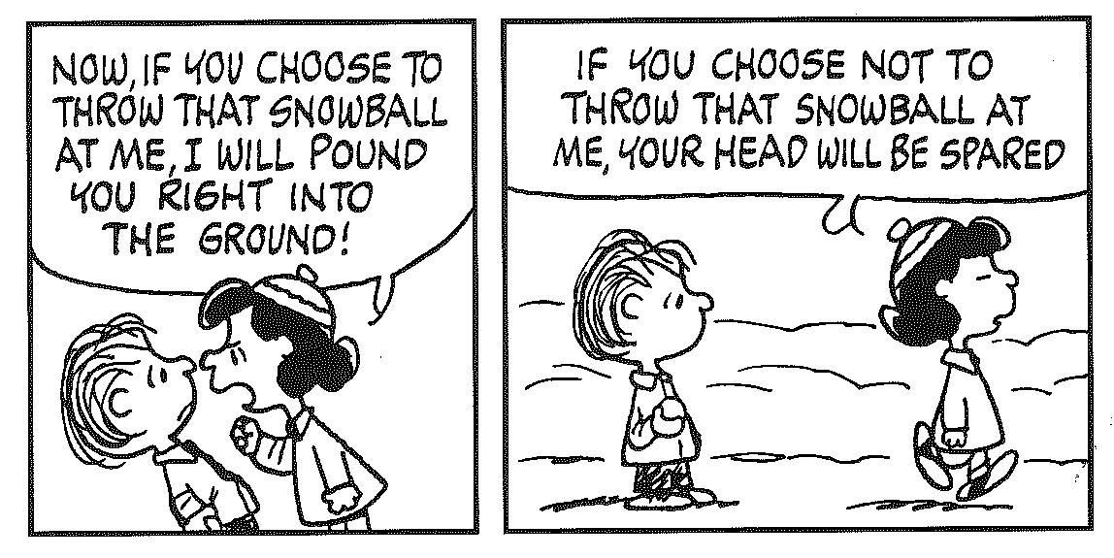

Slide 29
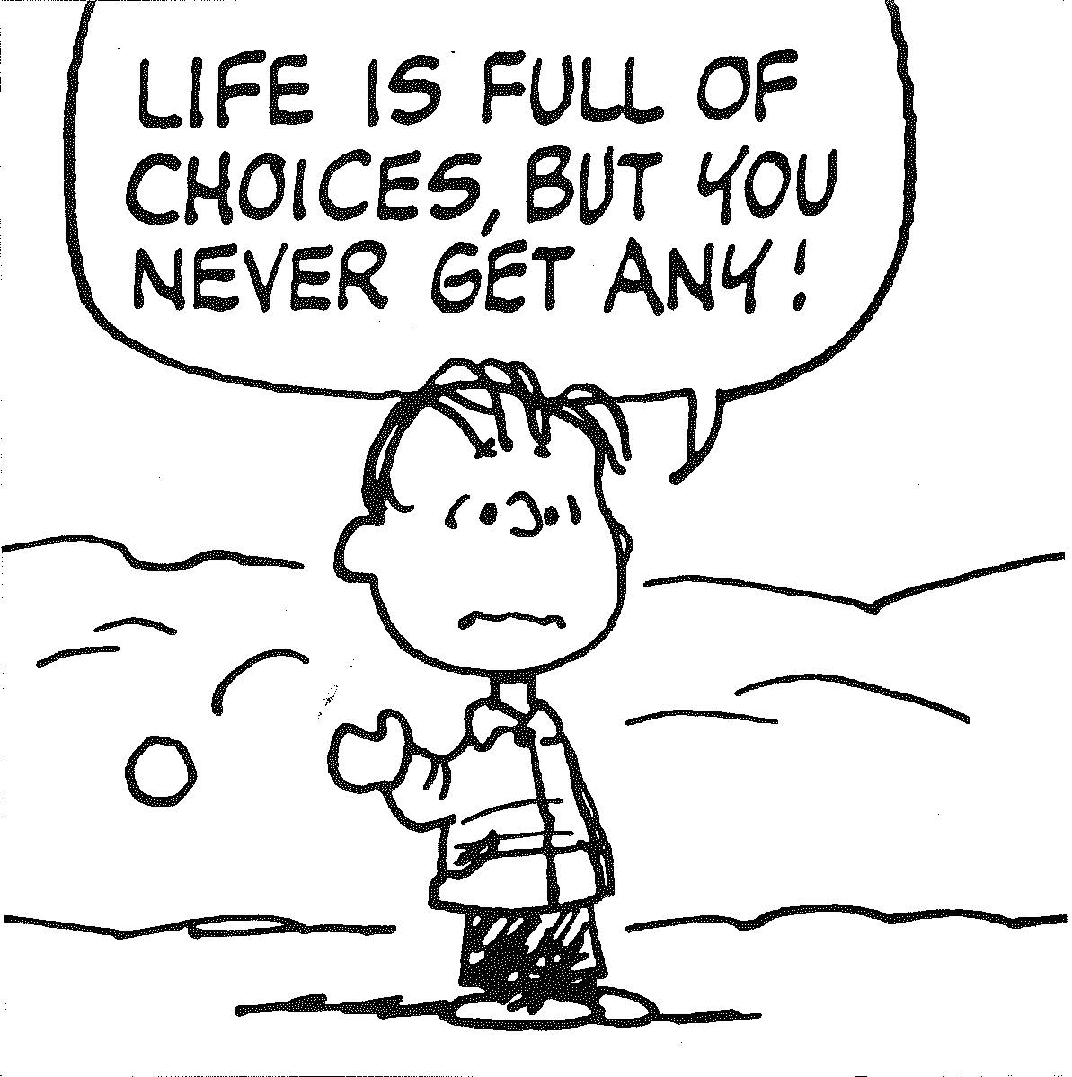

Slide 30
Mistake #4: Failure to have a master plan for you – and your family
Everyone needs a Master Plan – loving, caring instructions to care for you and your loved ones
Can this be done by an attorney who does not specialize in estate planning?
Like any building you need a good foundation

Slide 35
Lesson #1: Plan for the Storms -
Have a Good Estate Plan
One that will protect and provide for you for your life
One that will help protect your children from the storms of life
Crystal Clear
Flexible
Avoids Court Intervention in event of mental incapacity
Avoid Court intervention upon death
Keeps Legal Control in Your Family – with those you trust and you have selected to take charge

Slide 36
4 Basic Legal Tools Most Persons Should have
Note: These are legal tools virtually everyone should have
Regardless of whether you have $10,000 or much more
Living Revocable Trust that is properly Funded
Durable Power of Attorney
Health Care Surrogate
Pour-Over Will
Note: May not fulfill your wishes if not Up-to-date

Slide 37
The Fable Of the Porcupine and Duck
You have assets that are protected – and exposed

Slide 39


Slide 40
The Porcupine
Asset Protection Philosophy
Make Your Assets As Unattractive as Possible to Attack

Slide 41
The Porcupine
Asset Protection Philosophy
Make Your Assets As Unattractive as Possible to Attack
Timely
Not based upon concealment
Take Full advantage of Florida law
Asset Protection Trust as a core planning tool
Asset Protection Plan integrated with Estate Plan
Insurance as war chest

Slide 42
Not Dogmatic
1. Bias toward domestic planning vs. off-shore planning
2. Targeted to your unique risks and bundle of assets
3. Multiple options/strategies
4. Multiple layers
  5. No such thing as “Bullet proof”

Slide 43
Timing Is Critical!!!
FUFTA: Florida Uniform Fraudulent Transfer Act, F.S. 726
Cannot “hinder, delay, or defraud” creditors
Plan when waters are quiet – before
receive summons or default on payment

Slide 44
Not Based Upon Concealment
Tempting to transfer to family member
  - Risky: Likely can be clawed back – if not given back
- You have just made a gift – and there are gift tax issues
The power of modern discovery laws in all U.S. courts
Can reach everything you emailed, texted, instagramed, transferred, metadata, or tape recorded. (e.g. Hillary, Robert Mueller)
Attorney-client privilege not Sacred.

Slide 45
Take Full Advantage of Florida law
Free or low cost
Florida law offers multiple benefits for homeowners and business
Why go to Cayman Islands when you have Florida homestead?

Slide 46
3 FACES OF FLORIDA HOMESTEAD
$50,000 DEDUCTION ON PROPERTY TAXES
3% Save Our Homes Cap
THE BIG ONE: Protection against forced sale , i.e., foreclosure, protection from creditors
  No cap on the value of your homestead!

Slide 47
Florida Law Protections: Homestead
The Best and Biggest Florida Protection: FLORIDA HOMESTEAD
  Good reason to move to Florida (Remember the Juice: O.J.)
  Havoco: 1991 Florida Supreme Court Decision, 790 So. 2nd 1018 (Fla. 2001)
  Havoco obtained a $15,000 judgment against Hill. 3 days before the judgment became enforceable, Hill purchased a $650,000 property claiming to make this property his homestead. Creditors argued property could not be protected homestead because Hill converted non-exempt assets into the homestead with the intent to defraud his creditors. Despite the obvious intent to defraud the creditors, the court found the homestead was protected.

Slide 48
Take Away Points for Florida Homestead
Never transfer homestead to corporation, LLC or any entity other than a revocable trust: Check Your Deed!
You must occupy and intend it to be your permanent residence.
  Can rent out for short time and still maintain homestead,
  but be careful here
  Does not need to be “continuous uninterrupted physical presence”

Slide 49
Take Away Points for Florida homestead
4. If you have more than ½ acre in a municipality, only ½ acre is protected
  Note: Davie or Southwest Ranches
5. Non – residents citizens cannot qualify – but non-U.S. citizens who are Florida residents with a Green Card can
6. If you sell your homestead, keep proceeds in separate account and reinvest in new homestead within reasonable time – DO NOT COMMINGLE FUNDS!

Slide 50
Other Florida Law Protections
  IRA & Qualified Plan Benefits
  Wage Exemption
  Wage Accounts - but only for 6 months
  Life Insurance: both term and cash value
  Annuities

Slide 51
Tenancy By Entirety for Real Property
Vs. Creditor of Only 1 Spouse: Good
Vs. Creditor of Both Spouses: Bad
Ex: Both spouses sign personal guarantee on a business loan

Slide 52
Take Away Points for Tenancy By Entireties - TBE
1. No Protection for creditor against Husband & Wife
2. May lose Protection if one spouse dies
Underused and Overused
Take Away:
If married, why not have all savings and checkings accounts
As Tenants by Entireties? It is Free!

Slide 53
Using Florida Business Entities for
Asset Protection

Slide 54
Common Mistake
    The problem with bundling multiple properties in the same LLC

Slide 55
Multiple Properties in Same LLC
= Sitting Duck
PROPERTY #1
PROPERTY #2
PROPERTY #3
PROPERTY #4

Slide 56
CONTAIN THE VIRUS!!!!
LLC #1 PROPERTY #1 | LLC #2 PROPERTY #2
LLC #3 PROPERTY #3 | LLC #4 PROPERTY #4
PROPERTY #1
PROPERTY #2
PROPERTY #3
PROPERTY #4

Slide 57
Florida LLC vs. Corporation: Why The LLC Provides Higher Quality Asset Protection
1. Exclusive Remedy for Florida LLC is charging order if multi-member
  Remember: Our Florida legislature threw Single Member LLC’s Under the Bus in 2012!

Slide 58
LLC vs. Corporation: Why the LLC is usually higher quality protection
  Creditor has only rights of an assignee: Entitled to share in profits when distributed.
  No voice in LLC when distributions are made
  Distributions are made by Manager of the LLC
  No ability to change Manager
  Rev. Ruling 77-137 may require assignee of a partnership to report the income attributable to debtor’s partnership interest
  Tactic: Threaten Creditor with a K-1

Slide 59
Florida LLC vs. Delaware LLC#
1. Viable solution if do not have second member
2. Delaware Single Member LLC

Slide 60
Why Every LLC Should Have A Robust Asset Protection Operating Agreement
  If no operating agreement, may be considered single member
    Tip: Articles of Organization + Beautiful Corporate Book = No Protection
  Default status: without operating agreement LLC is member-managed
  Practice Note: Do Not Form LLC without strong Operating Agreement with Anti-Olmstead provisions

Slide 61

What’s Protected – What’s Exposed
PROTECTED | EXPOSED – Sitting Ducks
Florida Homestead | 2ND vacation house
IRA’s, 401K, Qualified Plans | Investment properties
Life Insurance – and cash value | Non-qualified equities, bonds
Florida Pre-Paid College Fund and 529 | Single Member Florida LLC
Wage Accounts - but only for 6 months | Checking/Savings account – if not TBE
Wages if dependents | Boat – if not in LLC

Slide 62


Use Insurance as a war chest – so a target?

Slide 63
Using Non-Florida Law

Slide 64
Florida does not permit self-settled spendthrift trusts
Your Florida Revocable Living Trust Provides Zero Protection
17 states do
Top Tier States:
  Nevada
  Delaware
  Alaska
  South Dakota

Slide 65
Advantages of Nevada Domestic Asset Protection Trust (DAPT)
  Allows self-settled trusts
  No state income tax
  2 year statute of limitations for future creditors
  2 year statute of limitations or 6 months from date of discovery for pre-existing creditors
  No pre-existing torts exception creditors

Slide 66
Limitations of DAPT
  Need Corporate Trustee and Must Pay corporate Trustee
  Control issue: Settlor cannot be Trustee – but can have Protector that controls Trustee
  Distributions are discretionary but have Protector to direct payments to you
  Conflict of laws for Florida domiciliary: Full faith and credit (Ex. Florida real estate: Florida law will likely apply)

Slide 67
Off-Shore Planning

Slide 68
Off-Shore Planning Cautions
  Not for avoidance of income taxes!!!
  Not just for very wealthy
  Quality off-shore jurisdictions
  Predictability of off-shore jurisdictions vs. U.S. Court system and the “result oriented” judge.
  Not a substitute for avoiding filing bankruptcy

Slide 69
Why Consider Off-Shore Planning
  Completely change rules of the game
  “Self-settled trust” rule is not applicable
  No full, faith and credit: U.S. judgments not recognized
  Need trial de novo
  No contingent fees: Creditor must pay the local attorney as litigation proceeds; substantial retainer required

Slide 70
  “Loser pays” us usually applicable.
  Creditor must post bond: In Nevis money 100,000
    (about $37,000 U.S. dollars)
  Higher standard of proof: “beyond a reasonable doubt”, the traditional American criminal standard.
  Burden of proof is always on the creditor
  Short fuse: A shorter statute of limitations. Often statue begins when assets transferred to trust. U.S. law usually 4 years; several off-shore have 2 yr. S/L
  Statute of Elizabeth overruled. This is the English forerunner of our Fraudulent conveyances act.

Slide 71
Why Not to Use Off-Shore Planning
    Cost
    More IRS Reporting#
        FATCA: Foreign Account Tax Compliance Act
        FBAR: Report of Foreign Bank and Financial Accounts

Slide 72
Popular & Established Off-Shore Jurisdictions
    Nevis
    Cook Islands

Slide 73
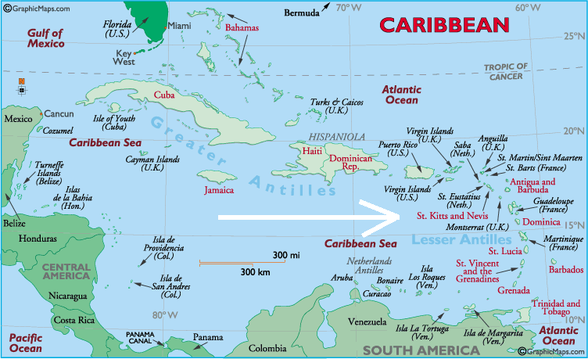
NEVIS

Slide 74
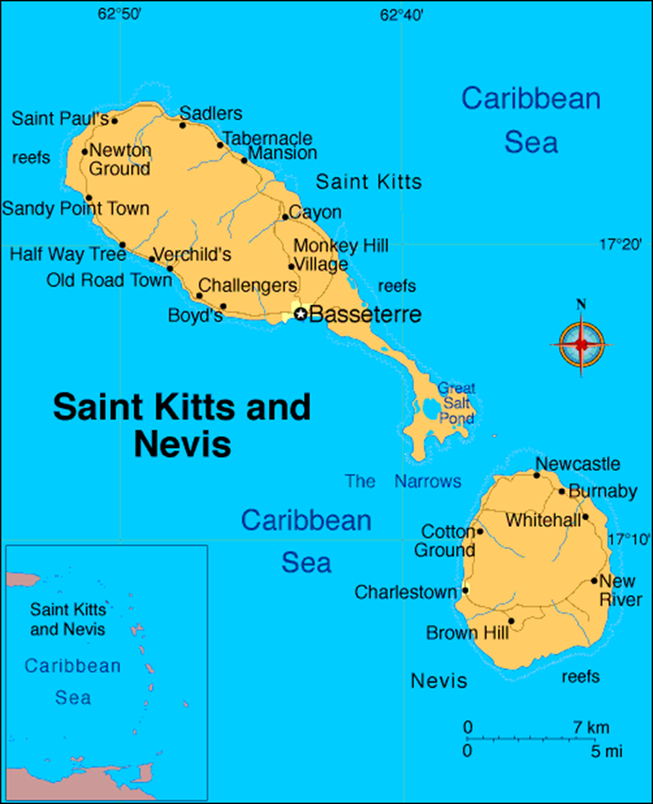
Nevis

Slide 75
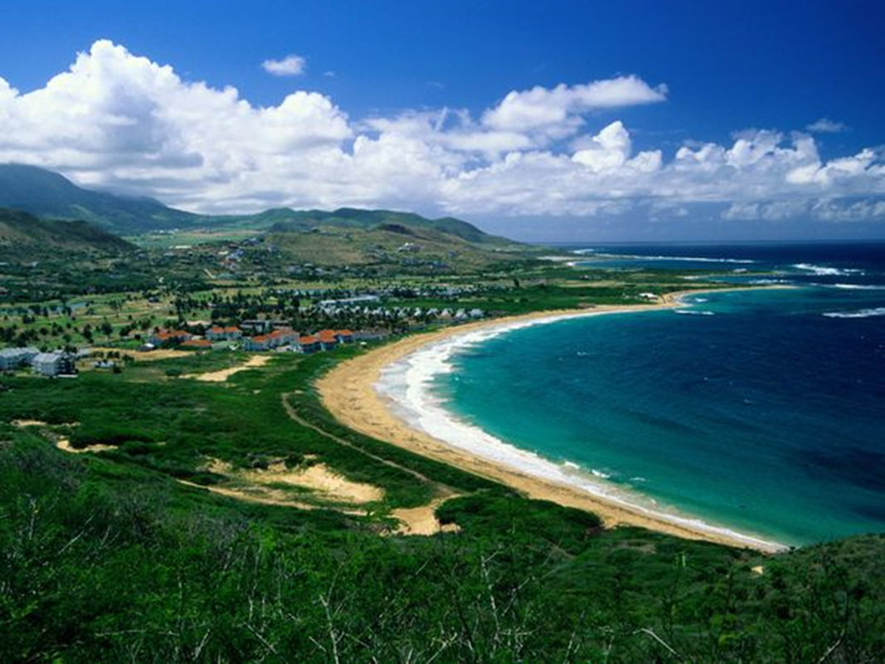
NEVIS

Slide 76

NEVIS - Four Seasons Marriott

Slide 77
What and Where: Nevis & St. Kitts
  Sovereign Country; Member of British Commonwealth And United Nations (Participated in the Olympics)
  British Parliamentary System
  Politically stable: 96% literacy rate: highest in Western hemisphere
  Population: 12,000; Main City: Charlestown
  Birthplace of Alexander Hamilton
  Clean history vs. Cayman vs. BVI vs. Bahamas

Slide 78
Advantages of Nevis LLC:
    More control than off-shore trust
    Less Expensive than Off-Shore Trust
    Strongest, Most Comprehensive laws: Have all benefits stated above: Ex: Has “beyond reasonable doubt” standard
    Geographical proximity (vs. Cook Islands)
    $37,000 bond and local Attorney Problem for creditors
    No local taxes
    Record to date is 100%: No U.S. creditor has successfully secured judgment in Nevis
    LLC law similar to Florida: Has Tenants by Entireties

Slide 79
Structure of a Nevis LLC
Operating Agreement Similar to Florida LLC
    Manager-Managed
    Manager: Can be client (if no threat)
If threat can transfer to off-shore Manager,
    Members: Your client or off-shore Trust

Slide 80
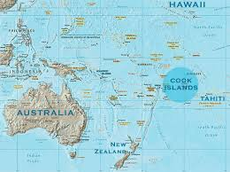
Cook Islands

Slide 81

Cook Islands Manuia Beach Resort

Slide 82
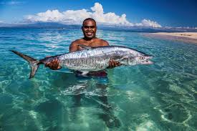
COOK ISLANDS

Slide 83

COOK ISLANDS

Slide 84
Cook Islands
  Sovereign country in free association with New Zealand
  Population: about 60,000
  Representative democracy with a parliamentary system
  Capital is Rarotonga (10,572 in 2011)
  Economy: tourism, off-shore banking, pearls, marine and fruit exports
  Banking/trust system mostly influenced by New Zealand attorneys

Slide 85
Advantages of Cook Island Trust:
    Most established and most tested : original situs for foreign asset protection trust law
    Have all benefits stated above for Nevis:
    “beyond reasonable doubt”, trial de novo
    3. Economy is highly dependent on strong trust laws

Slide 86
COOK ISLAND
IRREVOCABLE
ASSET PROTECTION TRUST
FLORIDA
HOMESTEAD
Larry & Sue, TBE
NEVIS LLC
EQUITIES & CASH
Swiss Bank Account
VACATION HOME #1
Florida LLC
FLORIDA REVOCABLE LIVING TRUST
For Larry
FLORIDA REVOCABLE LIVING TRUST
For Sue
SUE
MEDICAL PRACTICE, P.A.
LARRY
MEDICAL PRACTICE, P.A.
BOAT LLC
Delaware LLC or
Florida multi-member
LLC
Lease
Lease
OFFICE BUILDING, LLC
Florida LLC
Larry: 50% as TBE with Sue
Sue: 50% as TBE with Larry

Slide 87
Take-Away Points for Off-Shore Planning
1. Consider a Nevis/ Cook Island LLC or trust as a component or principal part of any Off-shore plan
2. IRS Reporting Requirements must be followed
3. If properly structured, assets are well protected from most creditors other than Super Creditors - IRS, SEC, FTC

Slide 88
Fraudulent Transfers
  FUFTA: Florida Uniform Fraudulent Transfer Act, F.S. 726
  A Civil Remedy – Not Criminal remedy

Slide 89
Transfers Under F.S. 726.105
  A transfer is fraudulent if made “with actual intent to hinder, delay, or defraud any creditor of the debtor”. Creditor may rely upon the “badges of fraud”
  Big Reg Badge of Fraud: Insolvency
  The debtor was insolvent or became insolvent shortly after the transfer was made or the obligation was incurred
  Leave some percentage of assets out of asset protection structure

Slide 90
Florida Statute of Limitations:
4 years after transfer made or if later, within 1 year after the transfer was or reasonably could have been discovered. F.S. 726.110(1).

Slide 91
FINAL TAKE AWAY
Protect the ball
The Porcupine Effect

Slide 92
The Porcupine vs. Cheetah

Slide 93

Porcupine vs Cheetah

Slide 94
The Porcupine Effect

Slide 95

Rarick & Beskin, P.A.
Miami-Dade
6500 Cowpen Rd., Suite 204
Miami Lakes, FL 33014
www.rblawfl.com
Tel: (305) 556-5209
E-mail: prarick@raricklaw.com
Rarick & Beskin, P.A.
Broward
3109 Stirling Rd.
Suite 101
Ft. Lauderdale, FL 33312
Tel: 954-861-1426
Email: info@raricklaw.com

