Slide 1
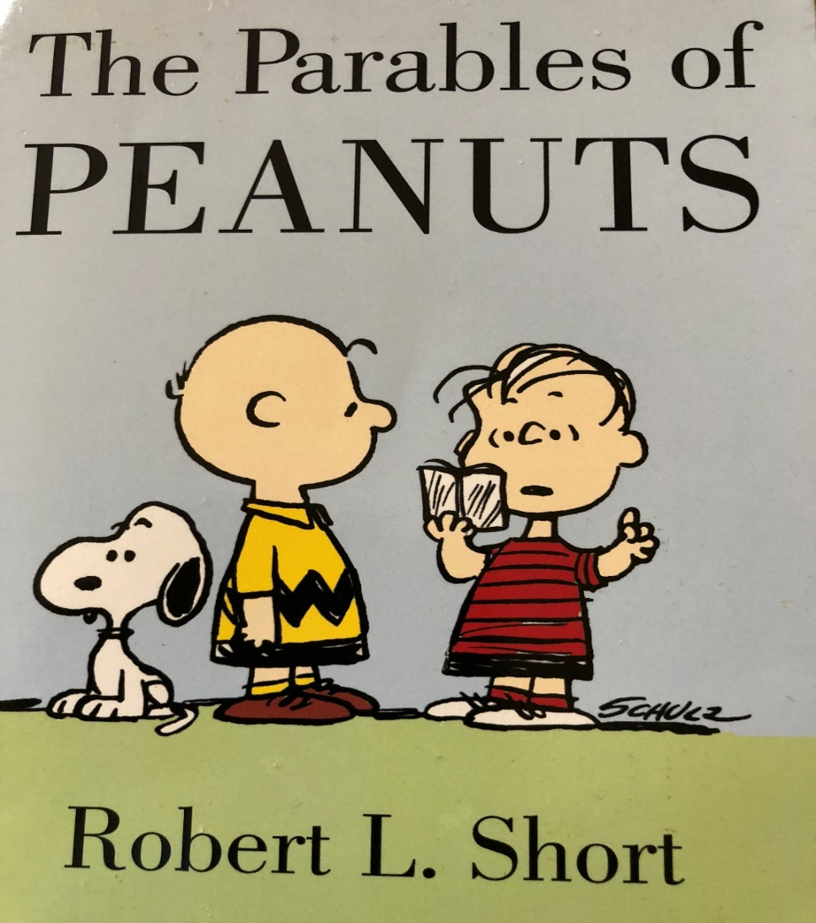
SMART ESTATE PLANNING – AS SEEN THROUGH THE WISDOM OF PEANUTS

Slide 2
Life Is Like A Baseball Game

Slide 5

Some Issues too tough!

Slide 6
Uncertain World
Let’s talk about how best to keep control – whether it rains or shines

Slide 7
Smart Estate Planning: Keeping
Control In The Family
As Americans, we are used to having control
No one wants the court to intervene in your personal affairs
Losing Control: In event of mental incapacity:
  Over 87% chance likely to suffer mental incapacity prior to death
  What could happened in such event? GUARDIANSHIP
  What is Guardianship?

Slide 8
Keeping Control In The Family
Probate: Court intervention upon death
What is Probate
Why most families want to avoid probate
  Cost
  Time
  Stress

Slide 9
3 Myths About Probate – and the Realities
A will avoids probate
A non-funded living trust avoids probate
Owning real estate with adult child avoids probate

Slide 10
Common Estate Planning Mistakes

Slide 11


Mistake #1: Failure to Protect Your Low Hanging Fruit
What assets are low hanging fruit?
Is it a porcupine or a fat duck?

Slide 12
What Makes a Fat Duck?
Title in your individual name – and loaded with insurance
Title in single member LLC
Multiple properties in same LLC
LLC without an anti-Olmstead Operating Agreement

Slide 13
What Makes A Fat Duck
Title in name of a sub-s corporation: Not Fat Duck but not optimal
Title in name of corporation – and no annual minutes or corporate Bank account
Watch out for the wolves

Slide 14


Slide 15


Who Survives?

Slide 16
Moral of the Story
Understand the Porcupine Strategy: Make Assets Unattractive to Creditors
The “No Fat Ducks Rule”

Slide 17
Mistake #2: Failure to Have An Asset Protection Strategy
Because if you don’t, someone else may
– as Linus learned the hard way

Slide 18
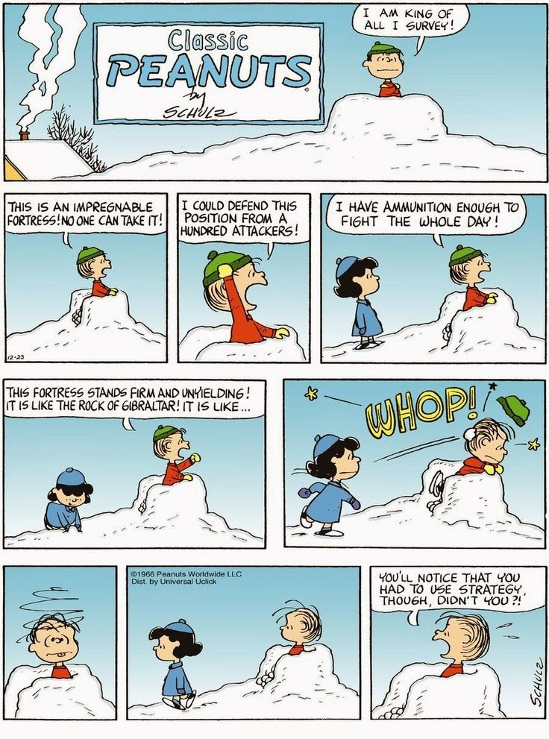

Slide 23
Take Away Points
Have an Asset Protection Strategy
  Take Advantage of Florida laws!!!
  If necessary, take advantage of laws of other states:
    Nevada, Delaware, South Dakota, Alaska
Make Sure Your Strategy is Up to date
No such thing as “umbrella insurance” policy
Not such thing as “bullet proof” strategy Or Impregnable Fortress
But Plenty of Powerful Legal Tools and Strategies – next seminar

Slide 24
Mistake #3: Waiting Too Long To Take Action
Plan when you can
  If you lack capacity – you are looking at court intervention
Crisis planning is expensive and your options are limited
Solution: Act Now
Even if the choices are not perfect – usually never perfect
Linus may agree

Slide 25


Slide 26
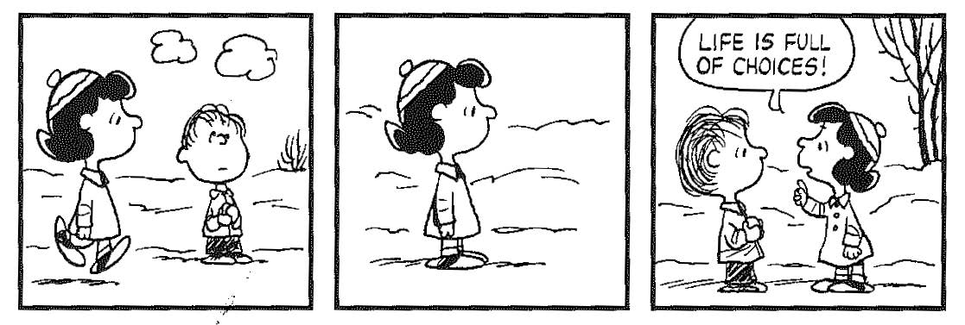

Slide 27
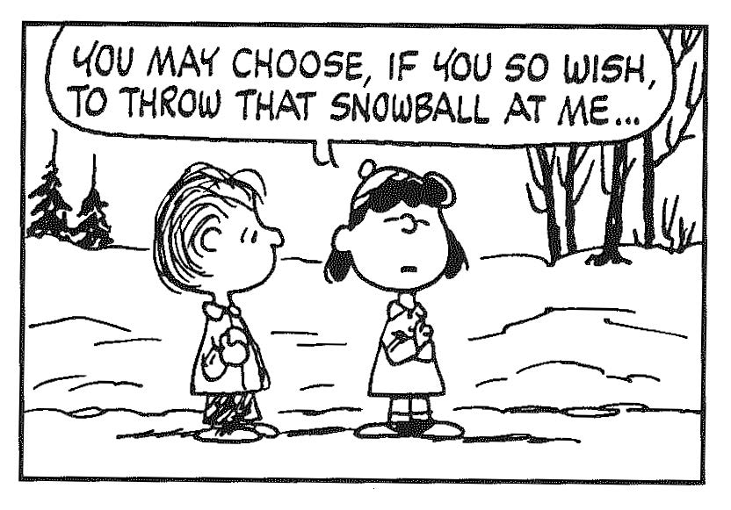

Slide 28
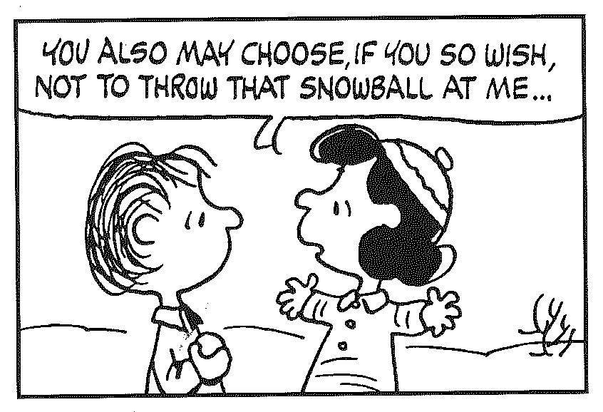

Slide 29
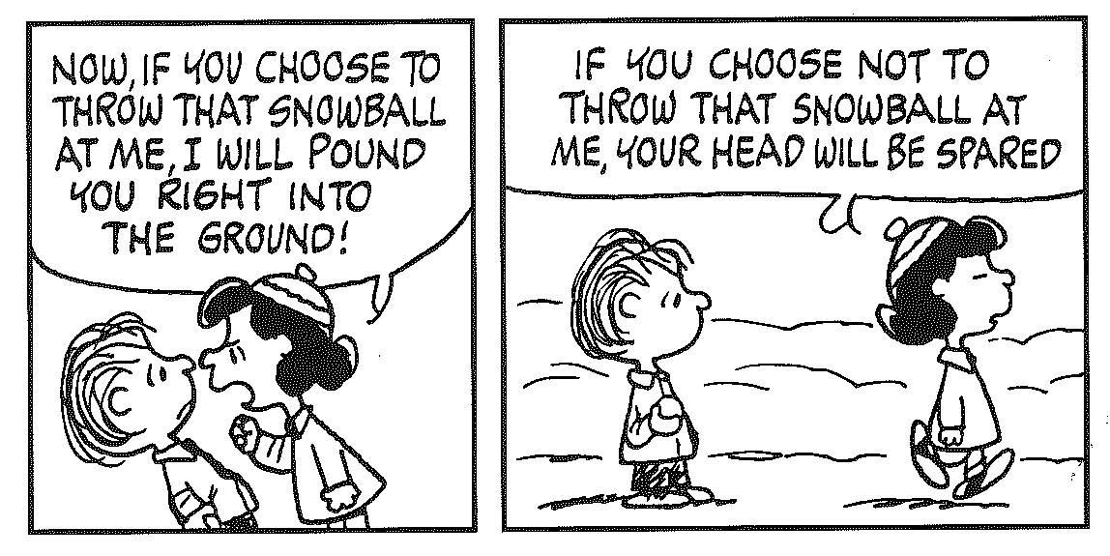

Slide 30


Slide 31
Mistake #4: Failure to protect your minor children – if you are not there
Naming a minor children the beneficiary of anything is always a MISTAKE
  Test: Have you named any minor children – or grandchildren – as beneficiaries of a life insurance policy – or annuity – or bank account?
Mother names 12 year old son as beneficiary of $50,000 life insurance policy
  Only Remedy is Guardianship: Cost: Min. $5,000
Solution: Safe Harbor Minor’s Trust inside your Living Trust

Slide 32
Mistake #5: Giving Outright Distributions To Young Adults
The Big Three Threats facing young adults over 18
  They will blow it
  Creditors will grab it
  A future spouse will claim it
Solution:
  No outright distributions until age where adult child is good money Manager
  Discretionary Safe Harbor Trust inside your Living Trust
    Key word is “Discretionary: No Demand Rights until certain age

Slide 33
Mistake #6: Failure to Update Your Trust or Will
Big Changes in the law
  New tax law: Tax Cut and Jobs Act: Effective January 1, 2018
    Estate tax illusion: 40% over $5.6 million in 2026
    Annual gifting: $15k per year
    Income tax issues now important in estate planning
  New LLC law
  New Durable Power of Attorney Law
Big Changes in your family
  New Grandkids?
  Marriages and divorces?

Slide 34
Mistake #7: Failure to have a master plan for you – and your family
Everyone needs a Master Plan – loving, caring instructions to care for you and your loved ones
Can this be done by an attorney who does not specialize in estate planning?
Like any building you need a good foundation

Slide 39
Solution #1: A Living Revocable Trust
Not complex: Simply detailed instructions to care for you and your loved ones
Names the persons you want to manage your financial affairs
  Not a Judge whom you have never met
Ensures every dime is used during your life for your needs – even down to the last penney
Helps ensure every dime at death goes to your loved ones – not their spouses
Helps ensure every dime is managed in a smart way

Slide 40
Note #1: A Living Trust Is Not A Pink Pill
A living trust must be funded to avoid probate
What is funding?
  Making sure that all your asset flow into your trust by way of title or beneficiary designation
Examples:
  Name Trust as primary beneficiary of your life insurance policies
  Name Trust as owner of your brokerage account
  Name Trust as Primary or Contingent Beneficiary of your IRA or 401k
    Note: Special considerations apply for Qualified Assets such as IRA or 401K
Take Away: If you have not reviewed your trust funding in past couple of years now is good time to do so

Slide 41
Note#2: Living Trust Does Not Provide Asset Protection for the Grantor
Powerful legal tool, but not an asset protection vehicle
Assets that flow into Trust should all be protected:
  Example: You have investment property in a multi-member LLC
  The LLC provides the protection; the trust avoids probate of the property

Slide 42
A Word About Your Homestead
The Big Three Benefits of Homestead
  $50,000 exemption
  3% Save our Homes cap
  Protection from creditors: This is the most valuable: Unlimited
Should your homestead be titled in your Trust?

Slide 43
Solution #2: Durable Power of Attorney
New law passed in 2012: Need a DPA prepared after 2012
Generally want to be super strong and comprehensive
Of course, give only to persons you trust 100%
If minimal assets, have strong provisions for Medicaid planning to address long term care
Check the date: Banks do not like – and may not honor - old DPA’s

Slide 44
Solution #3: Health Care Surrogate
Not talking about a Living Will or “Pull the Plug” legal instrument
A Powerful Legal Tool to cut through hospital bureaucracy
  Get a second opinion
  Access to records under HIPPA
  Fire the doctor and engage new one
  Get released from hospital – and find new one
Get this document in all your hospital records

Slide 45
Solution #4: Pour-Over Will
Simple, short will that pours into your trust anything you may have forgotten to put in the trust
Safety Net: May never be used if Trust is fully funded

Slide 46
What Makes A Good Estate Plan
One that will protect and provide for you for your life
One that will help protect your children from the storms of life
Crystal Clear
Flexible
Avoids Court Intervention in event of mental incapacity
Avoid Court intervention upon death
Keeps Legal Control in Your Family – with those you trust and you have selected to take charge

Slide 47
4 Basic Legal Tools Most Persons Should have
Note: These are legal tools virtually everyone should have
Regardless of whether you have $10,000 or much more
Living Revocable Trust that is properly Funded
Durable Power of Attorney
Health Care Surrogate
Pour-Over Will
Note: May not fulfill your wishes if not Up-to-date

Slide 48
Conclusion
What is going to happen?
No crystal ball, but next best thing:
Solid Plan to get you through the ups and downs of life
Don’t know what is going to happen – but keep on dancing!
Take Snoopy’s Attitude

Slide 52

Rarick & Beskin, P.A.
Miami-Dade
6500 Cowpen Rd., Suite 204
Miami Lakes, FL 33014
www.rblawfl.com
Tel: (305) 556-5209
E-mail: prarick@raricklaw.com
Rarick & Beskin, P.A.
Broward
3109 Stirling Rd.
Suite 101
Ft. Lauderdale, FL 33312
Tel: 954-861-1426
Email: info@raricklaw.com

