Slide 1



Asset Protection Essentials for the Florida Small Business Owner
Presented By:

Slide 2
Webinar Objective
Broad Overview of Basic Asset Protection strategies
Future webinars:
    Asset Protection Strategies for the Physician & High Risk Professional
    Maximizing Basis Step Up for Spouses
    Your Feedback is welcome
    Call Phil or Jay at (305) 556-5209

Slide 3
About Us
Phil Rarick
Jay Beskin
Locations:
Miami-Dade: 6500 Cowpen Rd, Suite 204, Miami Lakes
    Broward: 3109 Stirling Rd, Suite 101, Ft. Lauderdale
Other Southeast Florida cities served: Miami, Hollywood, Doral, Miramar, Hialeah, Pembroke Pines, Weston
Focus of practice

Slide 4
Introduction
Integrated Estate & Asset Protection Planning
      Definition
      Why important to integrate Estate Plan with Asset Protection Plan

Slide 5
The Asset Protection Ladder: Not all Entities are Equal

Slide 6
The Asset Protection Ladder
Off Shore Planning:
Domestic Asset Protection Trust: Nevada (or other top tier state such as Delaware, South Dakota, Alaska)
LLC: Limited Liability Company or LLLP: limited liability limited partnership
Corporation (Properly maintained)
Tenancy by Entirety (only for Husband and Wife)

Slide 7
SPECIAL NOTES#
Timing is critical
Not based upon concealment#

Slide 8
On Shore vs. Off-shore Asset Protection Planning
1. On-Shore vs. Off-Shore Bias
2. Our approach
      Not dogmatic
      Practical and budget sensitive
      Mutliple options/strategies to meet client’s objectives and budget
  3. Watch out:
      National Asset Protection “Experts” selling “Bullet proof” plans

Slide 9
Florida Law Protections
The Best and Biggest Florida Protection: FLORIDA HOMESTEAD
  Good reason to move to Florida (Remember the Juice: O.J.)

Slide 10
Take Away Points for Florida Homestead
Never transfer homestead to corporation, LLC or any entity other than a revocable trust
If you rent it & don’t occupy, you loose it.
  Caution for Medicaid Recipient Clients: Don’t ever rent if you must go to ALF
  You can only have one homestead
If you have more than ½ acre in a municipality, only ½ acre is protected
Non-Citizens can rarely qualify for homestead
If you sell your homestead, keep proceeds in separate account and reinvest in new homestead within reasonable time.

Slide 11
Other Florida Law Protections
  IRA & Qualified Plan Benefits
  Wage Exemption
  Wage Accounts - but only for 6 months
  Life Insurance: both term and cash value
  Annuities

Slide 12
Tenancy By Entirety for Real Property
Vs. Creditor of Only 1 Spouse: Good
Vs. Creditor of Both Spouses: Bad

Slide 13
Take Away Points for Tenancy By Entireties - TBE
1. No Protection for creditor against Husband & Wife
    Query: How many married couples have their cars in joint name? How many doctors have invested in real estate ventures and both doctor and spouse have signed personal guarantees or notes?
2. No Protection if one spouse dies
3. Underused and Overused

Slide 14
Take Away Point:
  Place large investment accounts in an LLC, not TBE

Slide 15
Using Business Entities for
Asset Protection

Slide 16
Internal Creditors vs. External Creditors - Watch Out for Both
Internal vs. External Creditors
    Internal creditor
    The problem with bundling multiple properties in the same LLC
External Creditors
    Auto accident
    Physician Malpractice
    Your friendly Yorkie that bites your neighbor

Slide 17
Florida LLC vs. Corporation: Why The LLC Provides Higher Quality Asset Protection#
1. Exclusive Remedy for Florida LLC is charging order if multi-member
      Note: Single Member LLC’s:
        Charging Order Not exclusive remedy

Slide 18
LLC vs. Corporation: Other Benefits of the LLC Over the Corporation#
  Creditor has only rights of an assignee: Entitled to share in profits when distributed.
  No voice in LLC when distributions are made
  Distributions are made by Manager of the LLC
  No ability to change Manager
  Rev. Ruling 77-137 may require assignee of a partnership to report the income attributable to debtor’s partnership interest
  Tactic: Threaten Creditor with a K-1

Slide 19
Restrictions On Assignability of LLC Interest#
  Operating Agreement can prevent assignment of LLC interest without consent of all members
  Even if assignable, assignee can be given no participation rights

Slide 20
Take Away Points: Florida LLC vs. Corporation#
  No similar Charging Order exclusive protection
  No similar protection for assignment of a shareholder’s stock in a corporation
  Director liability for unlawful distributions and other act
  Multiple remedies for creditor against corporation

Slide 21
Florida LLC vs. Delaware LLC#
1. Florida Single Member Problem
2. Delaware Single Member LLC

Slide 22
Why Every LLC Should Have A Robust Asset Protection Operating Agreement
  If no operating agreement, may be considered single member
  Default status: without operating agreement LLC is member-managed
  Practice Note: Do Not Form LLC without strong Operating Agreement

Slide 23
Domestic Asset Protection Trusts

Slide 24
Florida does not permit self-settled spendthrift trusts#
11 states do; Florida may be 12th
States that do: Alaska, Delaware, Utah, etc.

Slide 25
Advantages of Nevada Domestic Asset Protection Trust (DAPT)
  Allows self-settled trusts
  No state income tax
  2 year statute of limitations for future creditors
  2 year statute of limitations for 6 months from date of discovery for pre-existing creditors
  No spouse/child support exception for creditors: i.e. : ex-spouses
  No pre-existing torts exception creditors

Slide 26
Limitations of DAPT
  Need Corporate Trustee and Must Pay corporate Trustee
  Control issue: Settlor cannot be Trustee
  Conflict of laws for Florida domiciliary: Full faith and credit

Slide 27
Off-Shore Planning

Slide 28
Off-Shore Planning Cautions
  Not just for very wealthy
  Quality off-shore jurisdictions
  Predictability of off-shore jurisdictions vs. U.S. Court system and the “result oriented” judge Not for avoidance of income taxes
  Not a substitute for avoiding filing bankruptcy

Slide 29
Why Consider Off-Shore Planning
  Completely change rules of the game
  “Self-settled trust” rule is not applicable
  No full, faith and credit: U.S. judgments not recognized
  Need trial de novo
  No contingent fees: Creditor must pay the local attorney as litigation proceeds; substantial retainer required

Slide 30
  “Loser pays” us usually applicable.
  Creditor must post bond
  Higher standard of proof: “beyond a reasonable doubt”. This is the traditional American criminal standard.
  Burden of proof is always on the creditor
  Short fuse: A shorter statute of limitations will apply. Often statue begins when assets transferred to trust. U.S. law usually 4 years; several off-shore have 2 yr. S/L
  Statute of Elizabeth overruled. This is the English forerunner of our Fraudulent conveyances act.

Slide 31
Why Not to Use Off-Shore Planning
    Cost
    More IRS Reporting#
        FATCA: Foreign Account Tax Compliance Act
        FBAR: Report of Foreign Bank and Financial Accounts

Slide 32
Popular Off-Shore Jurisdictions
    Nevis
    Cook Islands

Slide 33
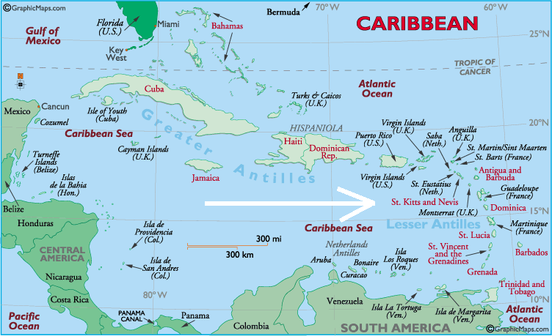
NEVIS

Slide 34
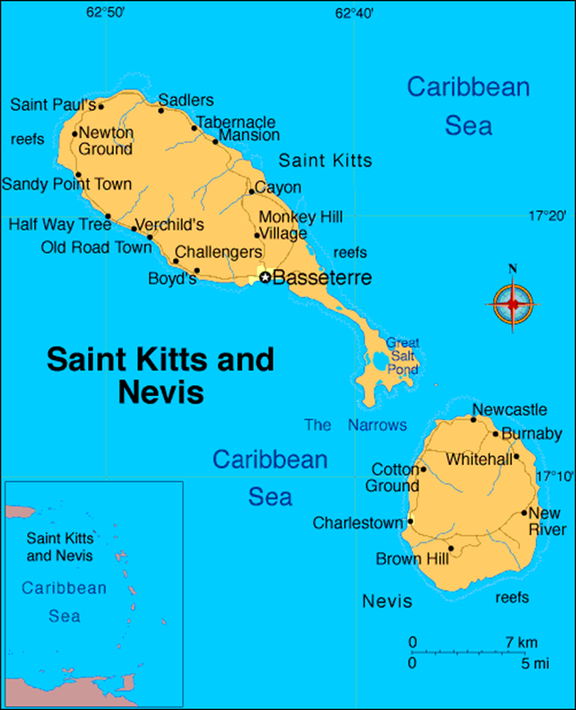
Nevis

Slide 35

NEVIS

Slide 36

NEVIS - Four Seasons Marriott

Slide 37
What and Where: Nevis & St. Kitts
  Sovereign Country; Member of British Commonwealth And United Nations (Participated in the Olympics
  British Parliamentary System
  Politically stable: 96% literacy rate: highest in Western hemisphere
  Population: 12,000; Main City: Charleston
  Birthplace of Alexander Hamilton
  Location: Southwest of Virgin Islands.

Slide 38
Advantages of Nevis LLC:
    More control than off-shore trust
    Less Expensive than Off-Shore Trust
    Strongest, Most Comprehensive laws: Have all benefits stated above: Ex: Has “beyond reasonable doubt” standard
    Geographical proximity (vs. Cook Islands)
    Local Attorney Problem for creditors
    No local taxes
    Record to date is 100%: No U.S. creditor has successfully secured judgment in Nevis
    LLC law similar to Florida

Slide 39
Structure of a Nevis LLC
Operating Agreement Similar to Florida LLC
    Manager-Managed
    Manager: Can be client
Can transfer to off-shore Manager,
Charges $1,000 annual management fee
    Members: Your client, domestic U.S. Trust, domestic
LLC, or off-shore Trust

Slide 40
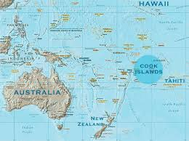
Cook Islands

Slide 41

Cook Islands Manuia Beach Resort

Slide 42
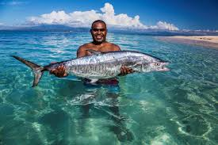
COOK ISLANDS

Slide 43

COOK ISLANDS

Slide 44
Cook Islands
  Sovereign country in free association with New Zealand
  Population: about 60,000
  Representative democracy with a parliamentary system
  Capital is Rarotonga (10,572 in 2011)
  Economy: tourism, off-shore banking, pearls, marine and fruit exports
  Banking/trust system mostly influenced by New Zealand attorneys

Slide 45
Take-Away Points for Off-Shore Planning
1. Consider a Nevis/ Cook Island LLC or trust as a component or principal part of any Off-shore plan
2. IRS Reporting Requirements must be followed
3. If properly structured, assets are well protected from most creditors other than Federal creditors

Slide 46
Fraudulent Transfers
  FUFTA: Florida Uniform Fraudulent Transfer Act, F.S. 726
  New Legislation: Florida Voidable Transfer Act
  Civil Remedy vs. Criminal

Slide 47
Transfers Under F.S. 726.105
  A transfer is fraudulent if made “with actual intent to hinder, delay, or defraud any creditor of the debtor”. Creditor may rely upon the “badges of fraud”
  Big Reg Badge of Fraud:
  The debtor was insolvent or became insolvent shortly after the transfer was made or the obligation was incurred

Slide 48
Florida Statute of Limitations:
4 years after transfer made or if later, within 1 year after the transfer was or reasonably could have been discovered. F.S. 726.110(1).

Slide 49
Final Take-Away Points
    Timing is critical
    Check how your clients hold title
    Asset Protection Checklist for the Florida Small Business Owner
    Florida Asset Protection: 7 Key Strategies For The Small Business Owner
    Insurance is not the sole answer: makes your client more attractive target
      The myth of “UMBRELLA INSURANCE”

Slide 50


TOO MUCH INSURANCE

Slide 51
FINAL TAKE AWAY
The Porcupine Effect

Slide 52
The Porcupine Effect

Slide 53
The Porcupine Effect

Slide 54
Future Webinars
  Asset Protection Strategies for The Physician & High Risk Professional
  Maximizing Basis Step Up For Spouses
  Your Feedback Is Welcome

Slide 55

Rarick & Beskin, P.A.
Miami-Dade
6500 Cowpen Rd., Suite 204
Miami Lakes, FL 33014
www.rblawfl.com
Tel: (305) 556-5209
E-mail: prarick@raricklaw.com
Rarick & Beskin, P.A.
Broward
3109 Stirling Rd.
Suite 101
Ft. Lauderdale, FL 33312
Tel: 954-861-1426
Email: info@raricklaw.com

